Slide 1
SPOOK

Slide 2
Overview - Sender
Runs continuously for a fixed time
Generates packets as fast as possible (no delays)
  Assigns each packet a sequential ID
  Timestamps each packet with nanosecond precision
  Packs sequence number and timestamp into a binary header
  Appends a fixed-size payload
Sends each packet via UDP to the target address
Increments the sequence counter after each send

Slide 3
What is the theoretical limit?
Kernel allocates stack/buffer for IP/UDP headers.
Copies payload from sender to receiver in memory (loopback)
Updates kernel socket state.
Signals the receiving socket.
Assuming 3 × 10⁹ cycles/sec per core and 300 cycles per packet
  10 million packets per second
Larger packets are bandwidth limited
  10 million per second * 65535 = ~1Terabyte / second
  Limited to ~ 5 to 20 GB/s

Slide 4
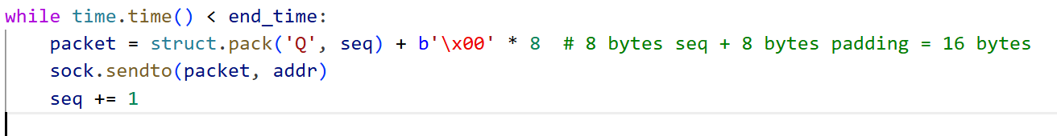
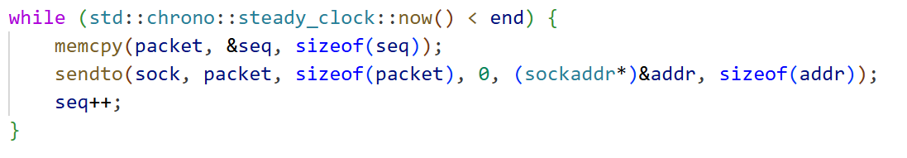
Python maximum Vs C++ Maximum on my hardware
Python
Packets sent: 2048243
Time elapsed: 10.001301s
PPS: 204797.66
C++
Packets sent: 2673470
Time elapsed: 10s
PPS: 267347
Receiver was off. Packets size was 16 bytes.
When receiver is off, the sender sends more – no travel through kernel and buffer?

Slide 5
Overview -Receiver
Listens indefinitely for incoming UDP packets on port 9000
Reads each packet up to 65,536 bytes
  Extracts sequence number and send timestamp from each packet
  Tracks expected sequence numbers to detect packet loss
  Counts total packets received
  Estimates packet loss by detecting sequence gaps
  Samples latency by subtracting send timestamp from receive time
  Records latency and CPU usage every 1,000 packets
Detects a STOP message to terminate processing and report results
  Calculates jitter (latency standard deviation)
  Computes latency percentiles (P50, P90, P99, P99.9)
  Reports min, max, average latency
  Reports average and peak CPU usage
  Generates a latency histogram with a normal distribution overlay

Slide 6
Things to test
We can measure effect of packet size on packets send per second
When packet size goes high, pps goes down
  Packet size has a max – investigate
Investigate buffer size
  Changing buffer size changes the packets lost metric
How does latency change with buffer size and packets per second?
What are the bottlenecks?

Slide 7
Battery Connection affects PPS & Latency – Max buffer and Packet Size
Metric | Charging | Not Charging
Socket Send Buffer | 2,147,483,647 bytes | 2,147,483,647 bytes
Packets Sent | 522,846 | 357,644
Time Elapsed (s) | 10.0013 | 10.0011
Packets Per Second (PPS) | 47,525.78 | 32,509.91
Throughput (MBPS) | 3,113.13 | 2,129.53
Metric | Charging | Not Charging
Samples Recorded | 522 | 357
Min | 0.000 | 0.000
P50 (Median) | 0.000 | 0.000
P90 | 0.000 | 0.000
P99 | 1,000.000 | 6,613.300
P99.9 | 16,762.100 | 15,100.400
Max | 16,762.100 | 15,100.400
Average | 111.976 | 172.371
Jitter (μs) | 1,184.710 | 1,259.242
Metric | Charging | Not Charging
Socket Receive Buffer | 2,147,483,647 bytes | 2,147,483,647 bytes
Packets Sent | 522,846 | 357,644
Packets Received | 522,846 | 357,644
Packets Lost | 0 | 0
Packet Loss % | 0.0000% | 0.0000%
Metric | Charging | Not Charging
Average CPU | 11.5% | 10.2%
Peak CPU | 75.0% | 28.6%

Slide 8
When the application buffer size is smaller than the UDP message
This is the max length of bytes the application will read from kernel
After making the receiver buffer smaller than datagram message, interestingly, it throws warning here.
Does not drop like in Kernel buffer
data, _ = sock.recvfrom(1)
^^^^^^^^^^^^^^^^
OSError: [WinError 10040] A message sent on a datagram socket was larger than the internal message buffer or some other network limit, or the buffer used to receive a datagram into was smaller than the datagram itself

Slide 9
Sender/Receiver Buffer Investigation
Sets the kernel send/receive queue for this socket
Windows minimum is 0 and maximum is 268435455 * 8 + 7 (31 bit binary. 1 bit for sign)
2 tests:
  Max packet size – UDP Limit of 65335. I send 65304 (exc. header of UDP and IPv6 - 28 bytes) ~50k p/s
  Min packet size – 16 bytes (Just the timestamp and sequence number) ~ 100k p/s
Receiver limited to python / kernel buffer drain / CPU max
Receiver Buffer investigation: Expect to see some packets drop at small kerner receiver buffer as it can’t hold them
Sender Buffer Investigation: Expect to see higher jitter as packets get put in buffer and then drained from sender side?

Slide 10
(Kernel) Sender Buffer > Receiver Buffer – Max Packet size
started to lose immediately: at expected 100 packets, we got packet num 1051
Max packet size – ~65507 bytes (due to the header) (im sending 8 * 8188 = 65504 bytes to allow for even buffer measurements)
Receiver still sees the 65504 bytes
STOP msg being cut off, added time.sleep()
Socket send buffer set to: 2,147,483,647 bytes
Packets send: 570849
Time elapsed: 10.0011901s
PPS: 51889.84
MBPS: 3398.993
Packet size: 65504 bytes
Packet loss decreases. Buffer size affects loss. Latency is stable, more about it later. Peak CPU is stable (less than min packet size)
Receiver Buffer Size (packets) | Receiver Buffer Size (bytes) | Packets Sent | Packets Received | Packet Loss % | P99 (µs) | P99.9 (µs) | Avg Latency (µs) | Jitter (µs) | Avg CPU (%) | Peak CPU (%)
0.0 | 0 | 558,206 | 542,677 | 2.7819 | 0.000 | 15,807.744 | 77.013 | 920.268 | 10.6 | 60.0
0< b<1 | 65,503 | 531,993 | 517,656 | 2.6950 | 0.000 | 15,641.856 | 237.161 | 1,729.071 | 11.9 | 100.0
1.0 | 65,504 | 518,234 | 513,431 | 0.9268 | 0.000 | 16,556.544 | 204.612 | 1,714.485 | 10.6 | 76.9
2.0 | 131,008 | 556,188 | 552,854 | 0.5994 | 0.000 | 16,529.408 | 73.054 | 956.122 | 11.2 | 100.0
10.0 | 655,040 | 553,982 | 553,710 | 0.0491 | 0.000 | 16,324.864 | 98.866 | 1,009.550 | 10.8 | 100.0
30.0 | 1,965,120 | 509,759 | 509,759 | 0.0000 | 0.000 | 15,834.880 | 91.829 | 945.508 | 10.5 | 100.0
100.0 | 6,550,400 | 565,973 | 565,973 | 0.0000 | 0.000 | 16,107.008 | 124.589 | 1,233.860 | 10.1 | 53.8

Slide 11
(Kernel) Sender Buffer > Receiver Buffer – Min PPS
Socket send buffer set to: 2,147,483,647 bytes
Packets send: 1026368
Time elapsed: 10.0088884s
PPS: 93230.94
MBPS: 1.491
Packets size: 16 bytes
Packet loss decreases. Buffer size affects loss. Latency is stable, more about it later. Peak CPU is stable (more than before)
16bytes buffer has no significant change in packet loss – possibly due to more overhead? Drop off at similar times (~30bytes)
Receiver Buffer Size (packets) | Receiver Buffer Size (bytes) | Packets Sent | Packets Received | Packet Loss % | P99 (µs) | P99.9 (µs) | Avg Latency (µs) | Jitter (µs) | Avg CPU (%) | Peak CPU (%)
0.00 | 0 | 1,098,517 | 1,081,856 | 1.5167 | 0.000 | 16,383.744 | 79.922 | 1,039.986 | 14.1 | 100.0
0.94 | 15 | 1,051,487 | 1,036,382 | 1.4365 | 0.000 | 16,080.640 | 79.474 | 987.419 | 14.7 | 100.0
1.00 | 16 | 995,893 | 980,927 | 1.5028 | 0.000 | 16,071.168 | 72.586 | 929.641 | 14.3 | 100.0
10.00 | 160 | 1,026,368 | 1,018,978 | 0.7200 | 0.000 | 16,566.784 | 65.974 | 930.736 | 15.9 | 100.0
30.00 | 480 | 1,080,522 | 1,079,752 | 0.0713 | 0.000 | 16,057.088 | 74.542 | 949.452 | 15.0 | 100.0
100.00 | 1,600 | 1,051,841 | 1,051,841 | 0.0000 | 0.000 | 16,105.984 | 122.673 | 1,312.647 | 14.8 | 100.0

Slide 12
Receiver Buffer Size (packets) | Receiver Buffer Size (bytes) | Packets Sent | Packets Received | Packet Loss % | P99 (µs) | P99.9 (µs) | Avg Latency (µs) | Jitter (µs) | Avg CPU (%) | Peak CPU (%)
0.00 | 0 | 1,098,517 | 1,081,856 | 1.5167 | 0.000 | 16,383.744 | 79.922 | 1,039.986 | 14.1 | 100.0
0.94 | 15 | 1,051,487 | 1,036,382 | 1.4365 | 0.000 | 16,080.640 | 79.474 | 987.419 | 14.7 | 100.0
1.00 | 16 | 995,893 | 980,927 | 1.5028 | 0.000 | 16,071.168 | 72.586 | 929.641 | 14.3 | 100.0
10.00 | 160 | 1,026,368 | 1,018,978 | 0.7200 | 0.000 | 16,566.784 | 65.974 | 930.736 | 15.9 | 100.0
30.00 | 480 | 1,080,522 | 1,079,752 | 0.0713 | 0.000 | 16,057.088 | 74.542 | 949.452 | 15.0 | 100.0
100.00 | 1,600 | 1,051,841 | 1,051,841 | 0.0000 | 0.000 | 16,105.984 | 122.673 | 1,312.647 | 14.8 | 100.0
Receiver Buffer Size (packets) | Receiver Buffer Size (bytes) | Packets Sent | Packets Received | Packet Loss % | P99 (µs) | P99.9 (µs) | Avg Latency (µs) | Jitter (µs) | Avg CPU (%) | Peak CPU (%)
0.0 | 0 | 558,206 | 542,677 | 2.7819 | 0.000 | 15,807.744 | 77.013 | 920.268 | 10.6 | 60.0
0< b<1 | 65,503 | 531,993 | 517,656 | 2.6950 | 0.000 | 15,641.856 | 237.161 | 1,729.071 | 11.9 | 100.0
1.0 | 65,504 | 518,234 | 513,431 | 0.9268 | 0.000 | 16,556.544 | 204.612 | 1,714.485 | 10.6 | 76.9
2.0 | 131,008 | 556,188 | 552,854 | 0.5994 | 0.000 | 16,529.408 | 73.054 | 956.122 | 11.2 | 100.0
10.0 | 655,040 | 553,982 | 553,710 | 0.0491 | 0.000 | 16,324.864 | 98.866 | 1,009.550 | 10.8 | 100.0
30.0 | 1,965,120 | 509,759 | 509,759 | 0.0000 | 0.000 | 15,834.880 | 91.829 | 945.508 | 10.5 | 100.0
100.0 | 6,550,400 | 565,973 | 565,973 | 0.0000 | 0.000 | 16,107.008 | 124.589 | 1,233.860 | 10.1 | 53.8

Slide 13
Receiver Buffer findings
Avg cpu usage decreases with higher packet size
Less packets to send as lower packets per second
Packet loss is higher with bigger packet size
Latency is negligible (only at end more latency comes) & will explain more later
Increasing buffer size decreased packet loss buffer size of non integer packet size gives no increase in packets seen – udp doesn’t fragment, just drops silently
No packet loss at max kernel buffer.
Python becomes bottleneck

Slide 14
Sender buffer > receiver buffer – MAX packet size
0 byte Sender buffer consistently lower than everything. Others are no difference. P99 is higher as well. – no packet loss
Receiver at max
Average and Peak CPU usage lower than Min packets
Sender Buffer Size (packets) | Sender Buffer Size (bytes) | Packets Sent | Packets Received | MB / seconds | Packet Loss % | P99 (µs) | P99.9 (µs) | Avg Latency (µs) | Jitter (µs) | Avg CPU (%) | Peak CPU (%)
0 | 0 | 492,857 | 492,857 | 2,934.06 | 0.0000 | 3,460.800 | 11,972.300 | 88.490 | 863.488 | 10.8 | 100.0
1/65504 | 1 | 590,607 | 590,607 | 3,512.16 | 0.0000 | 1,000.100 | 16,324.600 | 97.284 | 1,103.328 | 10.7 | 66.7
8/65504 | 8 | 583,524 | 583,524 | 3,473.39 | 0.0000 | 1,006.600 | 15,631.000 | 84.830 | 945.169 | 10.5 | 66.7
1024/65504 | 1,024 | 543,260 | 543,260 | 3,232.39 | 0.0000 | 1,000.100 | 16,252.800 | 87.645 | 1,028.303 | 11.5 | 66.7
~0.99 | 65,503 | 576,082 | 576,082 | 3,428.48 | 0.0000 | 1,018.700 | 7,816.000 | 47.659 | 494.463 | 11.4 | 100.0
1 | 65,504 | 572,706 | 572,706 | 3,406.78 | 0.0000 | 1,001.300 | 15,631.700 | 84.881 | 953.263 | 11.3 | 100.0
100 | 6,550,400 | 591,361 | 591,361 | 3,517.97 | 0.0000 | 1,009.700 | 16,000.000 | 78.023 | 935.682 | 10.4 | 60.0

Slide 15
Sender buffer > receiver buffer – MIN packet size
Only 0 again causing trouble
Receiver at max
Sender Buffer Size (packets) | Sender Buffer Size (bytes) | Packets Sent | Packets Received | MB / seconds | Packet Loss % | P99 (µs) | P99.9 (µs) | Avg Latency (µs) | Jitter (µs) | Avg CPU (%) | Peak CPU (%)
0 | 0 | 705,117 | 705,117 | 1.02 | 0.0000 | 862.700 | 10,726.300 | 47.302 | 593.389 | 12.9 | 100.0
1/16 | 1 | 1,018,444 | 1,018,444 | 1.48 | 0.0000 | 1,537.100 | 16,008.800 | 93.988 | 1,052.287 | 16.6 | 100.0
2/16 | 2 | 1,029,411 | 1,029,411 | 1.50 | 0.0000 | 2,005.300 | 16,158.700 | 117.744 | 1,167.093 | 16.0 | 100.0
3/16 | 3 | 1,104,904 | 1,104,904 | 1.61 | 0.0000 | 1,016.800 | 14,161.900 | 68.841 | 822.885 | 16.6 | 100.0
5/16 | 5 | 1,112,682 | 1,112,682 | 1.62 | 0.0000 | 1,002.400 | 10,873.600 | 42.508 | 575.161 | 15.9 | 100.0
15/16 | 15 | 1,110,432 | 1,110,432 | 1.61 | 0.0000 | 1,000.300 | 15,600.900 | 57.741 | 751.380 | 16.0 | 100.0
1 | 16 | 1,088,812 | 1,088,812 | 1.58 | 0.0000 | 1,019.600 | 15,975.000 | 73.594 | 909.327 | 15.8 | 100.0
16,384 | 2,147,483,647 | 1,087,823 | 1,087,823 | 1.58 | 0.0000 | 2,214.200 | 16,478.400 | 122.398 | 1,272.715 | 15.6 | 100.0

Slide 16
Sender Buffer Size (packets) | Sender Buffer Size (bytes) | Packets Sent | Packets Received | MB / seconds | Packet Loss % | P99 (µs) | P99.9 (µs) | Avg Latency (µs) | Jitter (µs) | Avg CPU (%) | Peak CPU (%)
0 | 0 | 705,117 | 705,117 | 1.02 | 0.0000 | 862.700 | 10,726.300 | 47.302 | 593.389 | 12.9 | 100.0
1/16 | 1 | 1,018,444 | 1,018,444 | 1.48 | 0.0000 | 1,537.100 | 16,008.800 | 93.988 | 1,052.287 | 16.6 | 100.0
2/16 | 2 | 1,029,411 | 1,029,411 | 1.50 | 0.0000 | 2,005.300 | 16,158.700 | 117.744 | 1,167.093 | 16.0 | 100.0
3/16 | 3 | 1,104,904 | 1,104,904 | 1.61 | 0.0000 | 1,016.800 | 14,161.900 | 68.841 | 822.885 | 16.6 | 100.0
5/16 | 5 | 1,112,682 | 1,112,682 | 1.62 | 0.0000 | 1,002.400 | 10,873.600 | 42.508 | 575.161 | 15.9 | 100.0
15/16 | 15 | 1,110,432 | 1,110,432 | 1.61 | 0.0000 | 1,000.300 | 15,600.900 | 57.741 | 751.380 | 16.0 | 100.0
1 | 16 | 1,088,812 | 1,088,812 | 1.58 | 0.0000 | 1,019.600 | 15,975.000 | 73.594 | 909.327 | 15.8 | 100.0
16,384 | 2,147,483,647 | 1,087,823 | 1,087,823 | 1.58 | 0.0000 | 2,214.200 | 16,478.400 | 122.398 | 1,272.715 | 15.6 | 100.0
Sender Buffer Size (packets) | Sender Buffer Size (bytes) | Packets Sent | Packets Received | MB / seconds | Packet Loss % | P99 (µs) | P99.9 (µs) | Avg Latency (µs) | Jitter (µs) | Avg CPU (%) | Peak CPU (%)
0 | 0 | 492,857 | 492,857 | 2,934.06 | 0.0000 | 3,460.800 | 11,972.300 | 88.490 | 863.488 | 10.8 | 100.0
1/65504 | 1 | 590,607 | 590,607 | 3,512.16 | 0.0000 | 1,000.100 | 16,324.600 | 97.284 | 1,103.328 | 10.7 | 66.7
8/65504 | 8 | 583,524 | 583,524 | 3,473.39 | 0.0000 | 1,006.600 | 15,631.000 | 84.830 | 945.169 | 10.5 | 66.7
1024/65504 | 1,024 | 543,260 | 543,260 | 3,232.39 | 0.0000 | 1,000.100 | 16,252.800 | 87.645 | 1,028.303 | 11.5 | 66.7
~0.99 | 65,503 | 576,082 | 576,082 | 3,428.48 | 0.0000 | 1,018.700 | 7,816.000 | 47.659 | 494.463 | 11.4 | 100.0
1 | 65,504 | 572,706 | 572,706 | 3,406.78 | 0.0000 | 1,001.300 | 15,631.700 | 84.881 | 953.263 | 11.3 | 100.0
100 | 6,550,400 | 591,361 | 591,361 | 3,517.97 | 0.0000 | 1,009.700 | 16,000.000 | 78.023 | 935.682 | 10.4 | 60.0

Slide 17
Kernel send buffer, receive buffer = 0
& effect on min / max packet size
Loss higher on bigger packet size.
Expected to see less packets (due to 0 send buffer) and more loss (due to 0 receiver buffer). Instead, loss is smaller because packet send rate is lower
Packet loss similar
Less CPU usage and more latency?
Packet Size (bytes) | Receiver Buffer Size (bytes) | Sender Buffer Size (bytes) | Packets Sent | Packets Received | MB / seconds | Packet Loss % | P99 (µs) | P99.9 (µs) | Avg Latency (µs) | Jitter (µs) | Avg CPU (%) | Peak CPU (%)
16 | 0 | 0 | 706549 | 696963 | 1.03 | 1.3567 | 1,046.100 | 16,692.600 | 120.791 | 1,166,747 | 12.5 | 100.0
65504 | 0 | 0 | 482810 | 475607 | 2872.54 | 1.4919 | 11,605.500 | 15,638.600 | 215.089 | 1,627,586 | 10.9 | 100.0

Slide 18
Latency
The latency is mainly affected by 2 things
1. The loop handling which increases time to measure (HP)
2. THEREFORE filling up the buffer
Localhost has negligible latency
Only the >0.01% of packets alter from negligible latency at low send times (<10 seconds) and make up
At higher send times (60s+), buffer fills up, with constant latency being added on to packets
Distribution for latency is skewed heavily

Slide 19
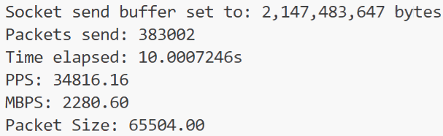
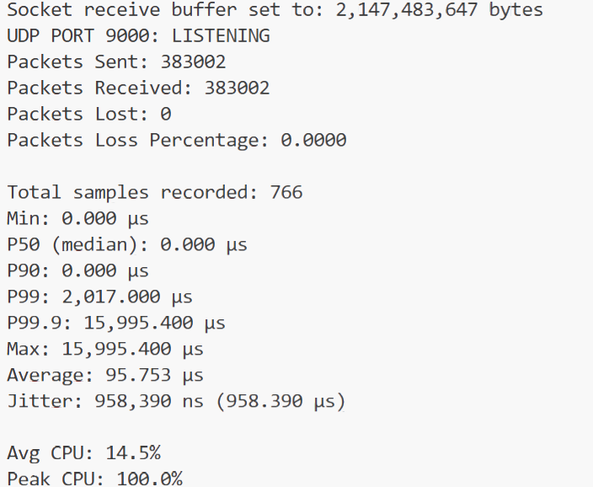
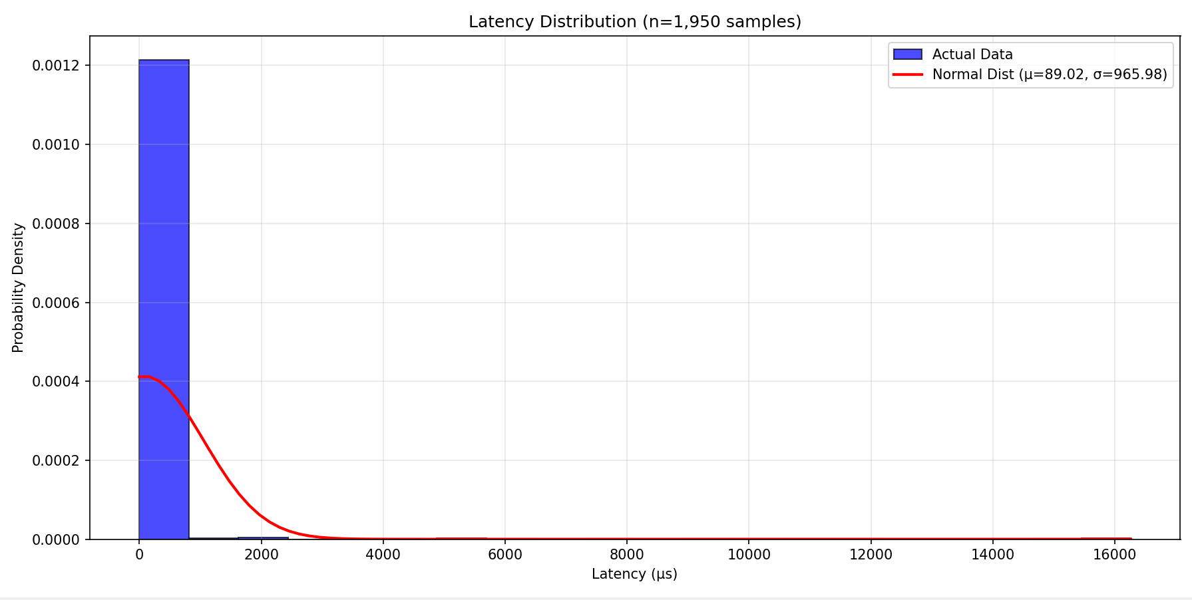
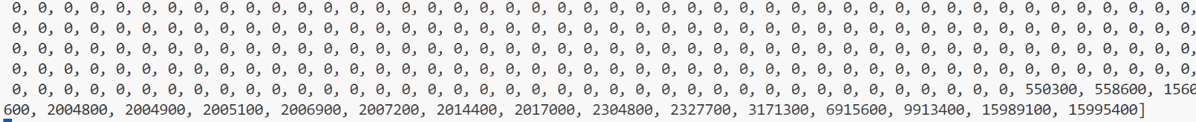
Latency – MAX Packet & Max Buffer size
Latencies keep increasing – Buffer is full
At approx. 749*500 = 374500 packets
Meaning only the last 8500 packets bring the latency way up
So buffer wasn’t filling up all the way till the end!
At 20 seconds, 29 *500, last 14,500 packets were delayed.
Some buffer issue every 500th packet below

Slide 20
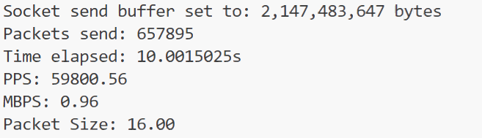
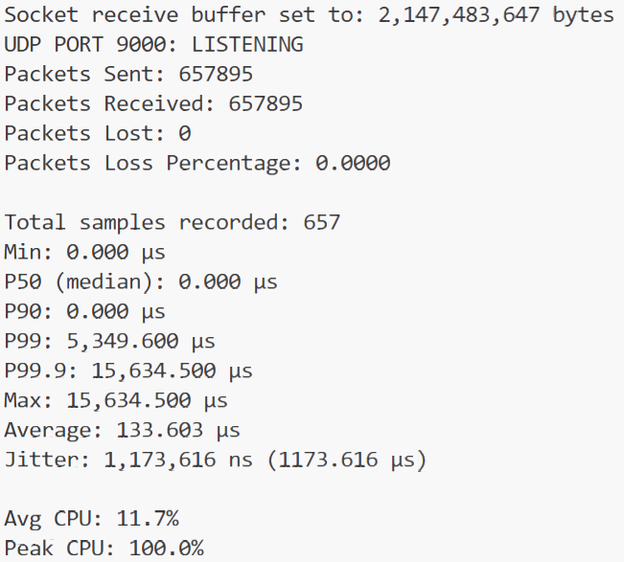
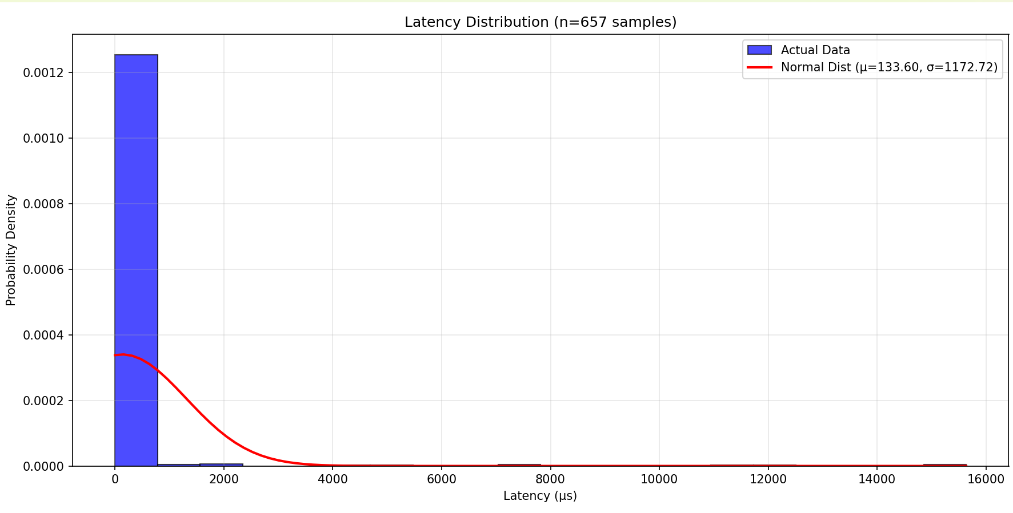
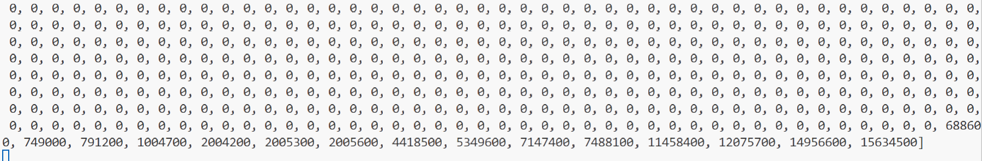
Latency – MIN Packet & Max Buffer size
Latencies keep increasing – Buffer is full
At approx. 642 * 1000 = 642,000 packets
Meaning only the last 15,895 packets bring the latency way up
Bigger percent than MAX packet size every 1000 packet below

Slide 21
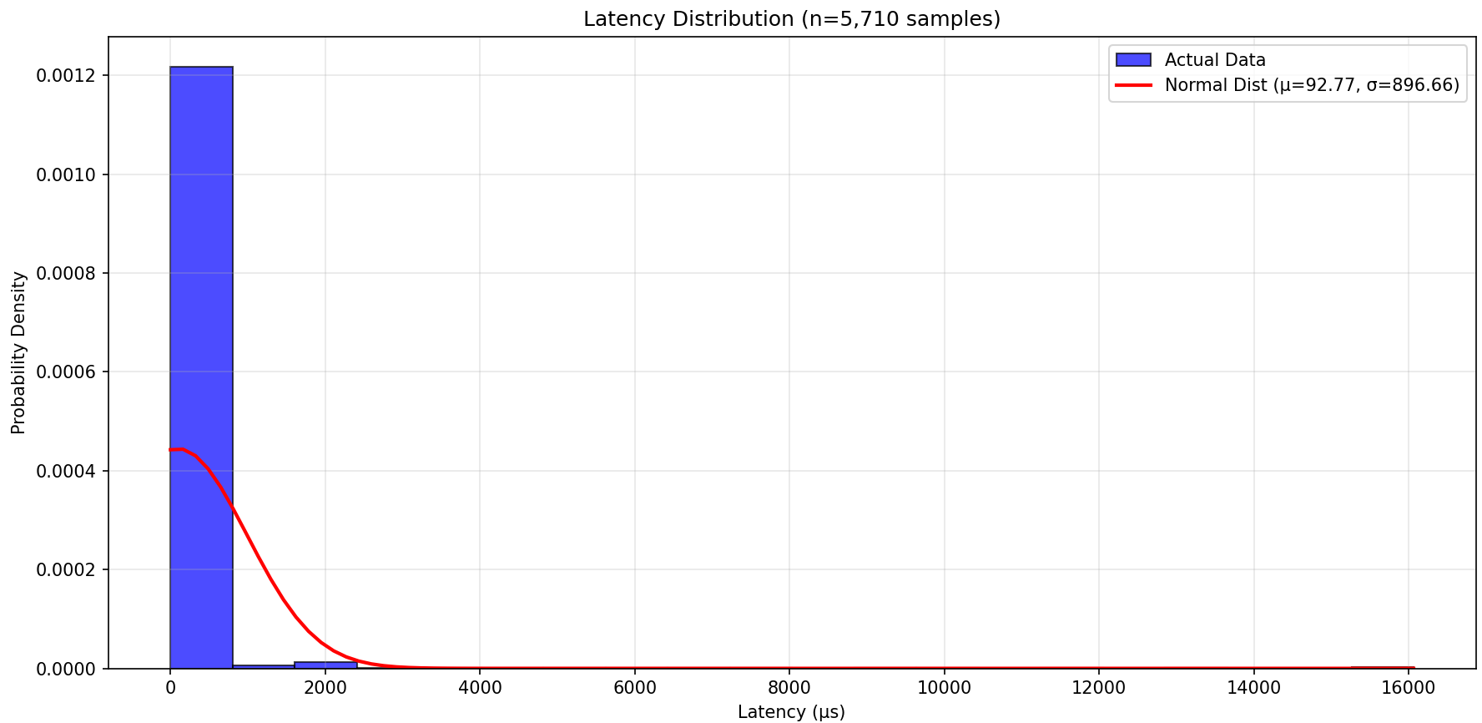
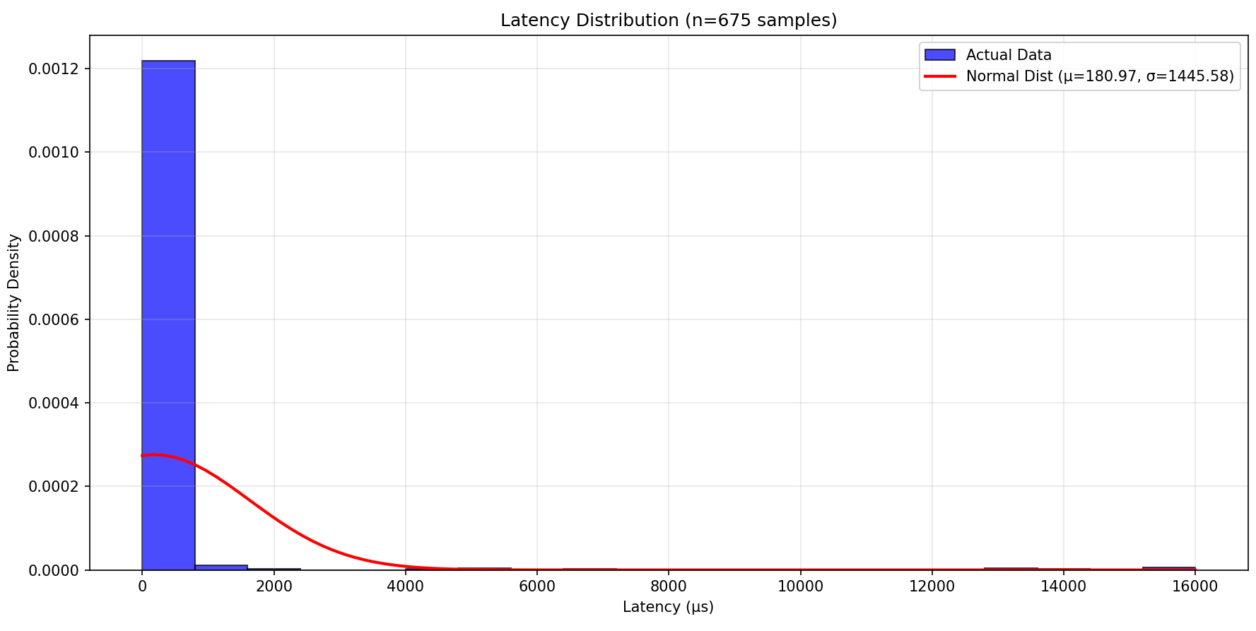
Latency on large vs small send times
Large send times, the higher latencies appear more bigger
Backs up my theory that buffer gets full and backlogs
60 seconds 10 seconds

Slide 22
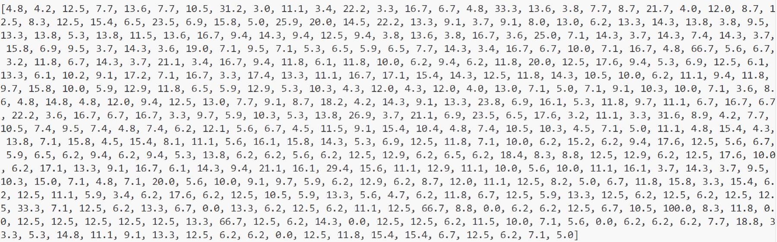
CPU Usage fluctuates –
CPU not bottleneck of program
It is the UDP packet size and buffer size which bottleneck it
The buffer only becomes a bottleneck if receiver loop isn’t fast enough
We have a python issue at hand
Even CPP bottlenecked way before CPU (Earlier slides)

Slide 23
Would this program have saturated a NIC?
Realtek 8822CE Wireless LAN 802.11ac PCI-E NIC 866700000
So yes?...
My max throughput was ~3.5 GB/s on Python, compared to ~900MB limit on NIC card.

